Slide 1

SUSTAINABLE FINANCING MECHANISMS FOR ROAD INFRASTRUCTURES – THE CASE OF MALAWI THE ROADS FUND ADMINISTRATION MALAWI
ASAFG MEETING, 13 - 16 APRIL 2026
SÃO MARTINHO HOTEL, BILENE, MOZAMBIQUE

Slide 2



PRESENTATION OUTLINE
Road Infrastructure in Malawi
Current Financing Status and Challenges
Innovative Financing Mechanisms
Governance and Transparency of Road Funds
Climate Change Adaptation in Roads
Collaborative Financing for Regional Corridors
Conclusion and Way Forward

Slide 3
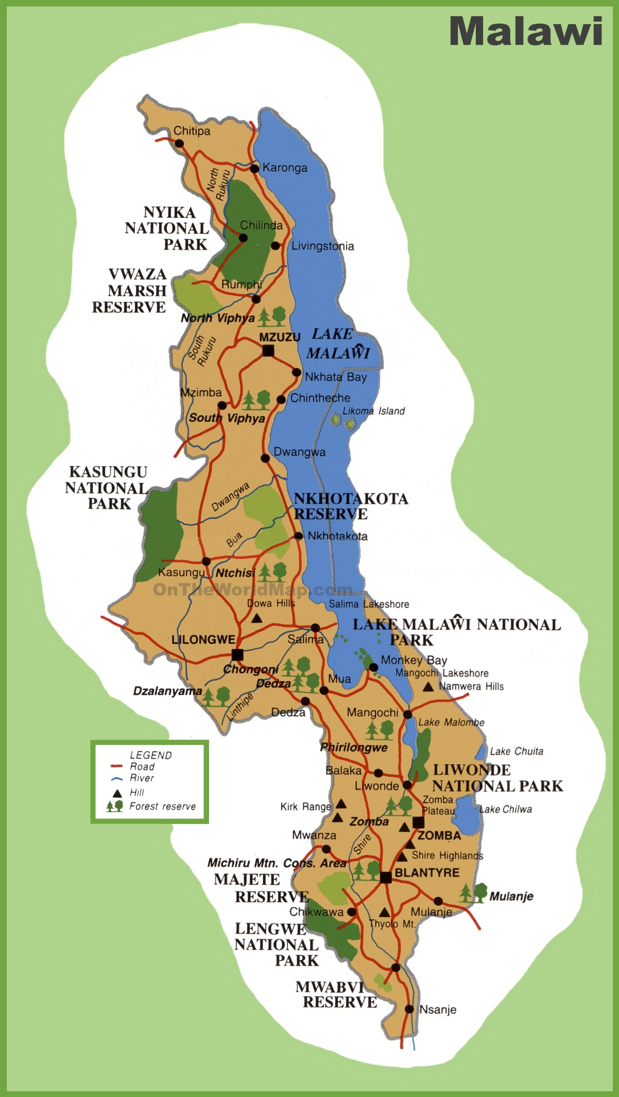
ROAD INFRASTRUCTURE IN MALAWI
Road infrastructure remains a critical enabler of Malawi’s socio-economic development.
As a landlocked country, Malawi depends heavily on its road network to facilitate domestic and international trade.
However, despite its importance, the road sector continues to face significant financing challenges.
The demand for road construction, rehabilitation, and maintenance consistently outpace available financial resources.
This has resulted in a growing backlog of road maintenance works and deterioration of road conditions.
3

Slide 4
CURRENT FINANCING STATUS AND CHALLENGES

Slide 5
FINANCING FOR PUBLIC ROADS IN MALAWI
In Malawi, road infrastructures are financed in two ways:
Category | Nature of Works | Source of Funding
Development Budget | New Construction Upgrading Major Rehabilitations | Donors/Cooperating Partners Government/Treasury
Recurrent Budget | Routine and periodic maintenance Rehabilitation Emergencies | The Roads Fund (Fuel levy, International transit fees and Toll fees)
5

Slide 6
CHALLENGES WITH DEVELOPMENT BUDGET
Overcommitments: More road development projects are commissioned more than the approved annual budgets and what Treasury can annually finance.
1. Inadequate Funding: Annual road development budgets are therefore on average about 30% of the commitments on the ground.
2. Delayed Payments: Attracting interest charges.
3. Prolonged Contract Periods: Projects get period extensions with associated costs.
4. Accumulation of Arrears: The Government continuously accumulates huge payment arrears and related contractual claims.
Effects of Overcommitments
6

Slide 7
CHALLENGES WITH RECURRENT BUDGET
Overreliance on Fuel Levy: Disruptions in fuel levy affect the Roads Fund’s capacity to finance road maintenance, rehabilitation and emergencies.
Low Toll Rates: Toll rates are relatively low, insufficient to meet the cost of road maintenance.
Huge Maintenance Backlog: The existing backlog is huge. It cannot be cleared by the Roads Fund alone. Supplementary funding is required.
Delayed Fuel Levy Remittances: Fuel levy collection challenges cause Roads Fund cashflow constraints and unreliable funding to implementing agencies.
Inadequate Funding: RFA is only able to finance less than 40% of the annual funding requirements. Road condition deteriorating further.
7

Slide 8
INNOVATIVE FINANCING MECHANISMS EXPLORED

Slide 9
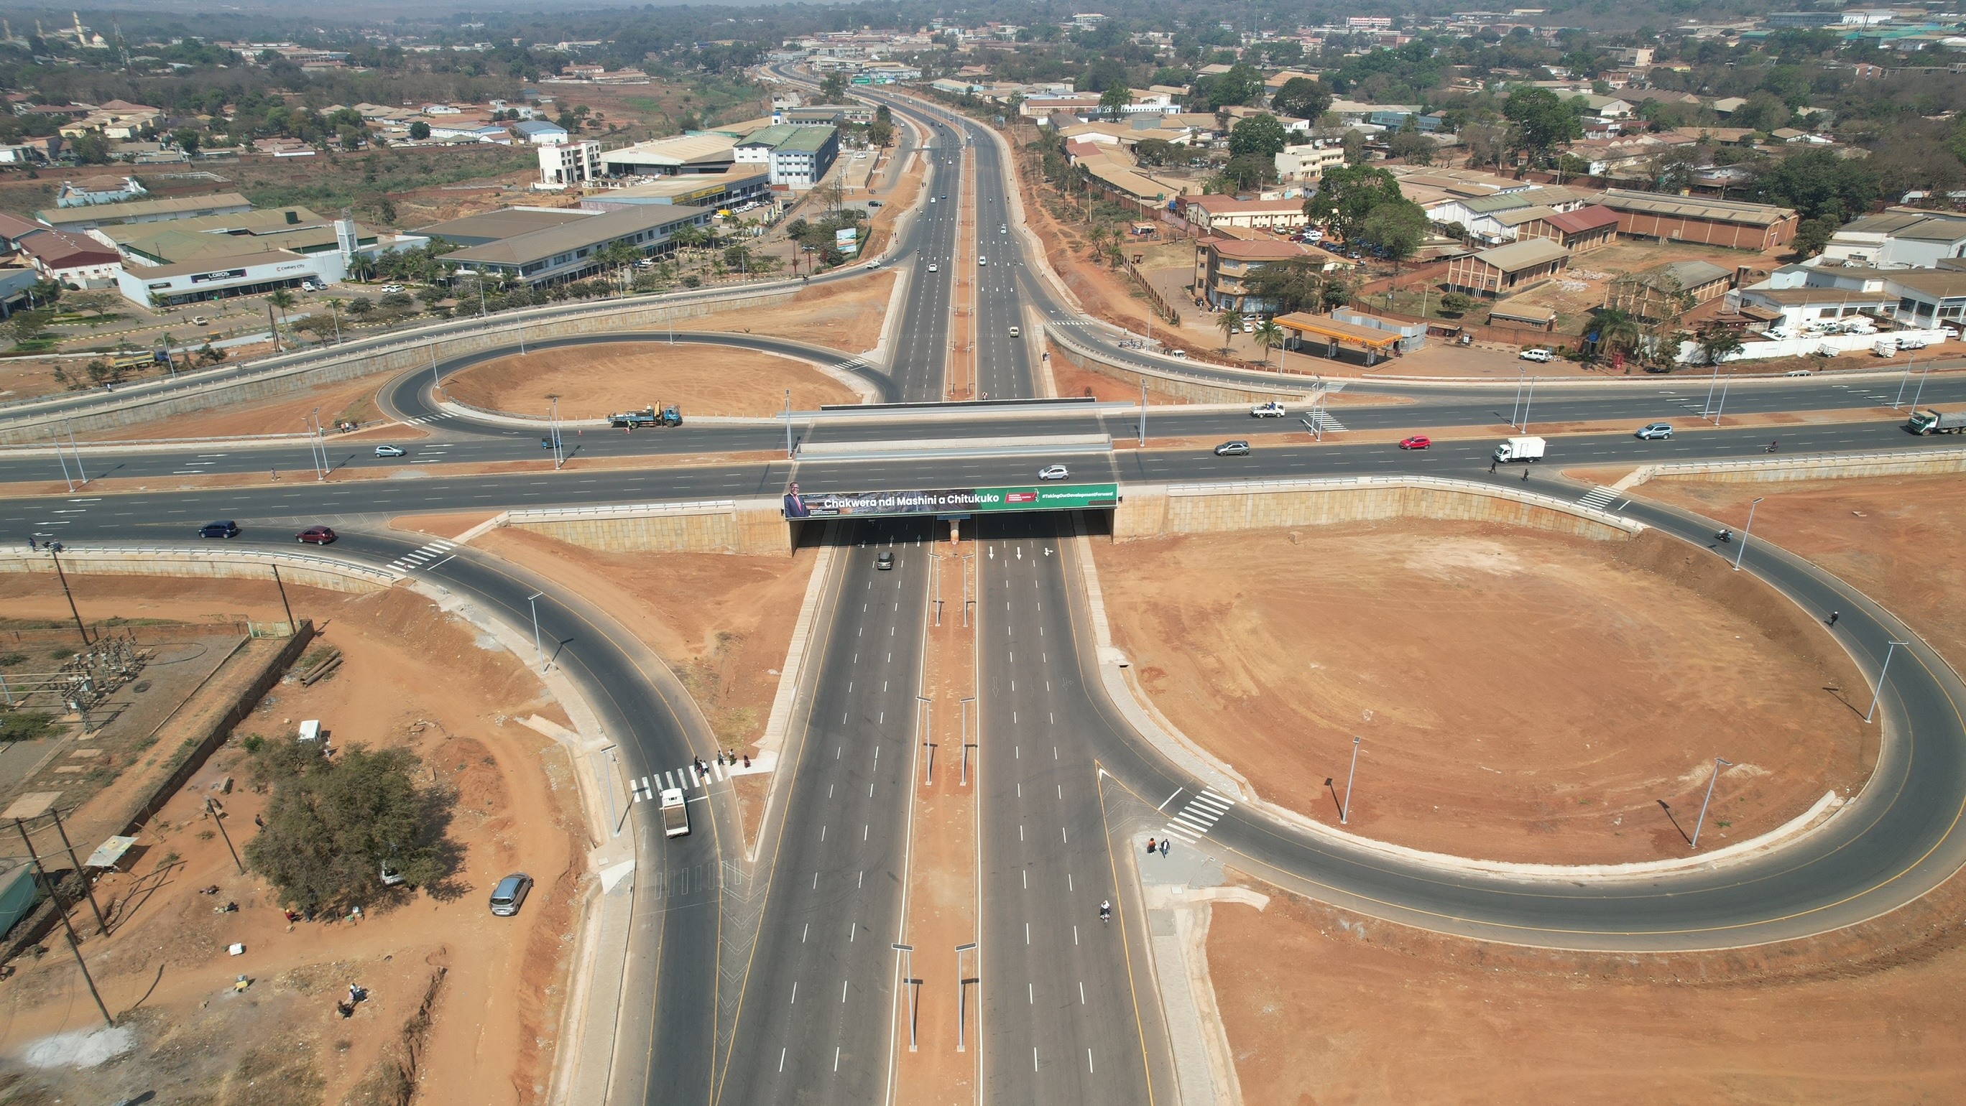
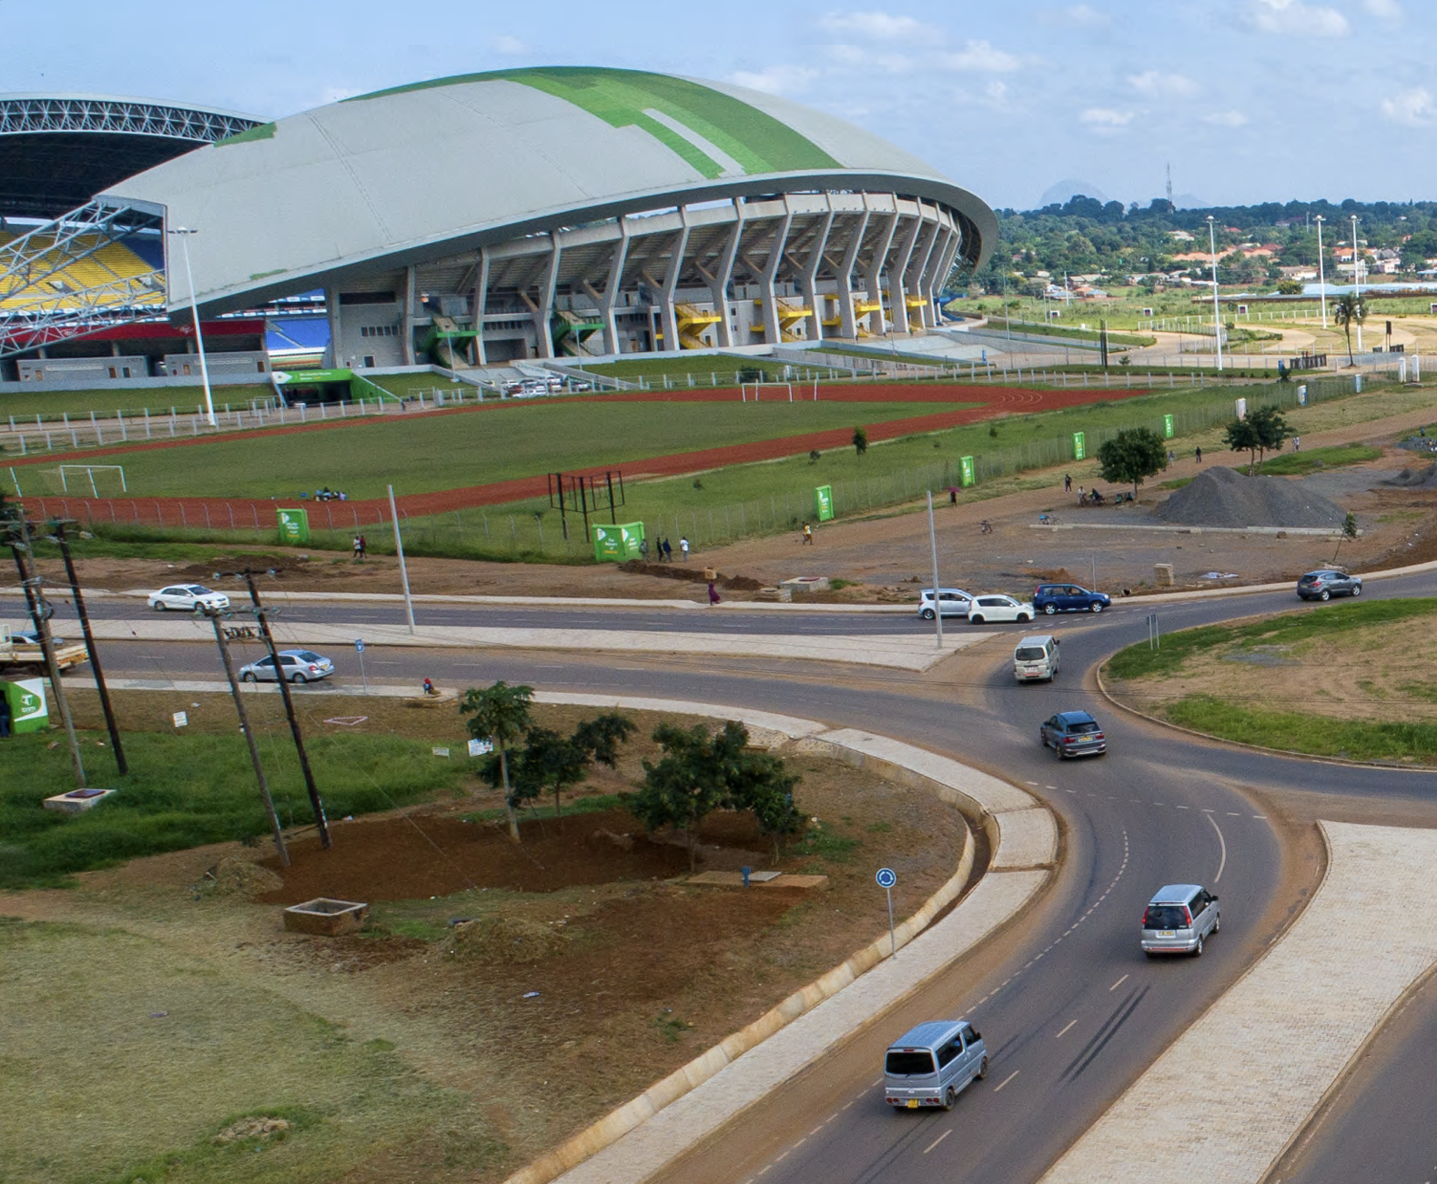
THE ROADS FUND BONDS
The RFA leveraged fuel levies to raise private bond financing from banks and pension funds to fund widening of city roads and construction of interchanges in Lilongwe City.
The RFA is arranging another bond of at least US$115 million in the 2026/2027 financial year for sections of two main roads.
9

Slide 10
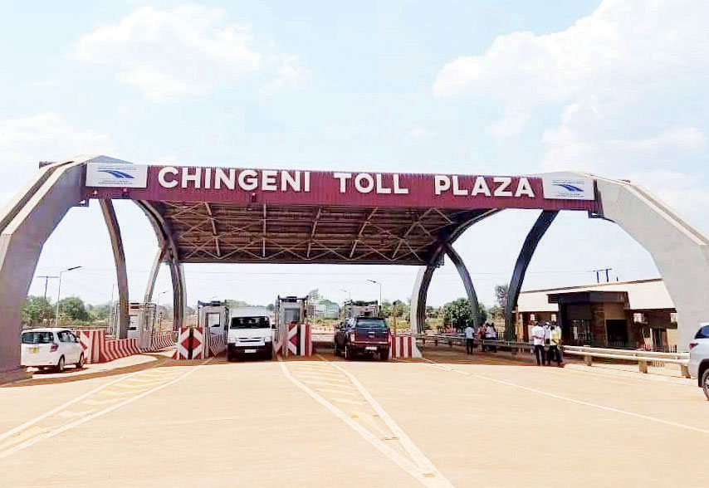
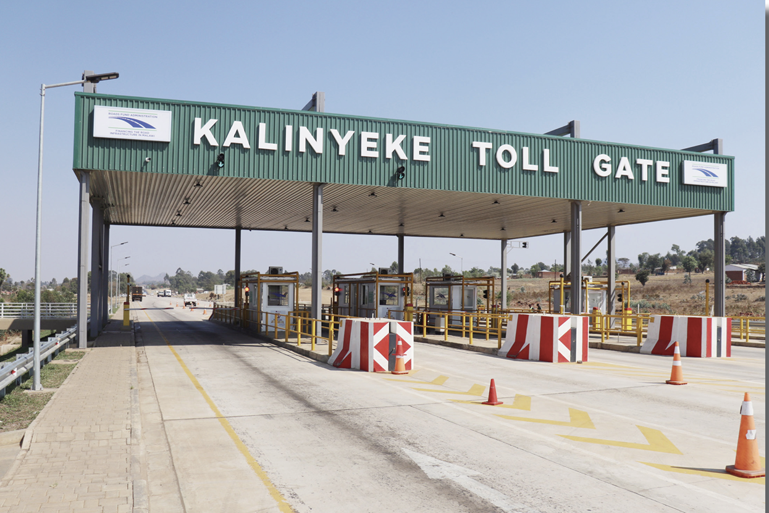
EXPAND THE TOLL GATES INITIATIVE
The RFA introduced tolling in 2021. Currently, there are two operational tollgates.
The RFA plans to construct four (4) new toll gates in the 2026/2027 financial year 2026/2027 following the unlocking of fuel levy remittances.
10

Slide 11
PUBLIC PRIVATE PARTNERSHIPS
CURRENT STATUS
INTENDED STRUCTURE
Malawi is pursuing Public-Private Partnerships (PPPs), where the private sector finances, constructs, and maintains road infrastructure, recovering its investment through toll revenues over a concession period.
The PPP approach reduces the immediate financial burden while transferring construction and operational risks to the private sector.
The initiative has been included in the RFA five-year Strategic Plan.
Within the 2026/2027 financial year, the RFA will visit ASAFG countries that are actively utilizing PPPs for insights and lessons.
This approach will enable the adoption of best practices, informed decision-making, and the avoidance of common pitfalls in structuring and managing PPP arrangements.
11

Slide 12
THE GOVERNANCE AND TRANSPARENCY OF THE ROADS FUND ADMINISTRATION

Slide 13
PILLARS OF GOVERNANCE AND TRANSPARENCY
Sound Legal Framework
The RFA was established by an Act of Parliament (Act No. 4 of 2006).
Road Fund revenues are ring-fenced for road rehabilitation and maintenance.
The RFA receives fuel levy and other revenues directly into its bank accounts.
Fuel levy is not gazetted. Fuel levy rates and administrative arrangements are open to changes by Government.
Strong and Independent Board
Majority private sector directors nominated by organisations they represent.
Ex-officio members cannot chair the Board or any Board committee.
The CEO and Heads of Departments are appointed by the Board.
Some provisions are not enforceable by the Board. The RFA continues to lobby with Government for their implementation.
13

Slide 14
PILLARS OF GOVERNANCE AND TRANSPARENCY
Separation of Agency Roles
The RFA Board reports to Ministry of Finance (and Roads Authority to Ministry of Transport). This minimises political interferences, enhances checks and balances and affords direct and easier lobbying for strategic road financing issues.
Reporting to a different ministry has had its own “created” incoordination challenges
Sound Financial Management Systems
Disbursements from the Roads Fund follow strict procedures. Only made for approved programmes in accordance with signed Financing Agreements and on written certifications of the implementing agencies.
Compliance inflexibility: Some best practice and lessons learned require Act revision for them to be implemented. (E.g. the Act prohibits the RFA from funding administrative expenses of local councils).
14

Slide 15
PILLARS OF GOVERNANCE AND TRANSPARENCY
Regular Technical and Financial Audits
One of the functions of the RFA is to monitor through audits the use of funds disbursed to the road agencies.
RFA audits have saved billions of Malawi Kwacha and enabled progressive performance improvements of road agencies.
There is currently no legal mandate for the RFA to reject certifications or enforce corrective action by the road agencies where value for money cannot be assured.
Regular Publications and Stakeholder Engagements
The RFA has mapped its stakeholders and tailors its engagements based on stakeholder categories.
There are regular publications of RFA activities and annual reports.
There is room for improvement in terms of the before and after audiovisuals
15

Slide 16
CLIMATE CHANGE AND ROADS INFRASTRUCTURE RESILIENCE

Slide 17
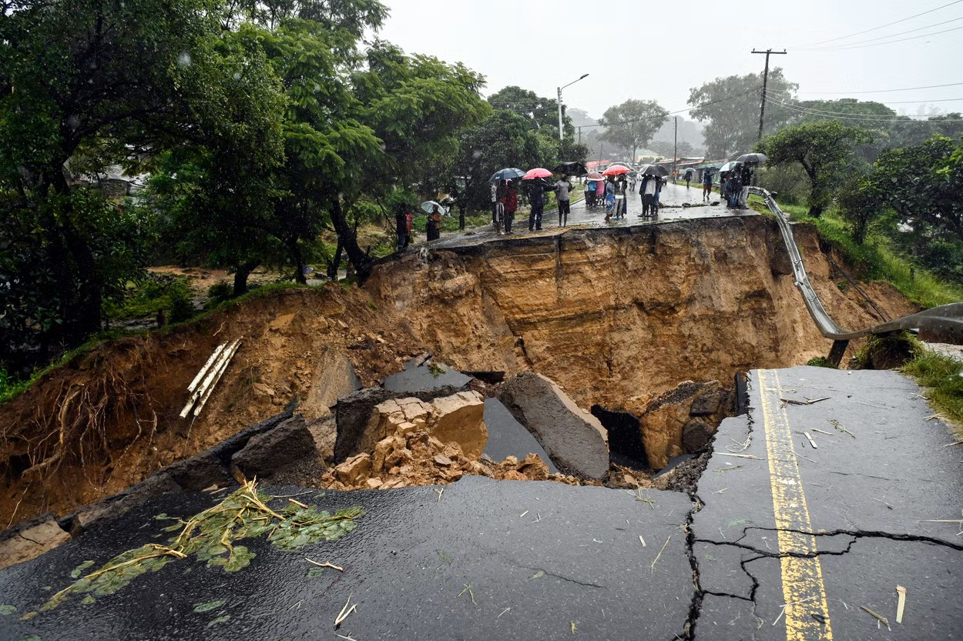
CLIMATE CHANGE – MALAWI CONTEXT
Climatic Location
Malawi’s high climate vulnerability is driven by its position between El Niño (eastern equatorial Africa) and La Niña (south-eastern Africa) systems
Recent Extreme Events
In the last 6 years Malawi has been affected with extreme events like tropical cyclones (Idai, Gombe, Freddy) and tropical storms (Ana)
Damaging 44 roads, over 40 bridgesand other road infrastructure across the country.
17

Slide 18
OBSERVED EFFECTS OF CLIMATE CHANGE
Road washouts and damages
Land slides and hill side slips
Untimely potholes, pavement bleeding and cracks
Earth road erosion
Earth road erosion
Increased dust and loss of material on earth roads
Bridge and culvert washaways
18

Slide 19
CLIMATE CHANGE INTEGRATION
Good drainage methods to prevent road washaways
Raised structures with suitable embankment supporting the road surface in crossing a gully, hollow or valley
Precontracting of Retainer Emergency Contracts assist manage emergency response times.
Increased paving of earth roads using Low Volume Seal Methods
Validation of claims on abnormal rains using “Working-day weather charts” from Department of Meteorological Services
Increased use of long span and fewer span bridges and box culverts complete with inlet and outlet aprons, wing walls and cut-off walls
19

Slide 20
COLLABORATIVE FINANCING FOR REGIONAL CORRIDORS

Slide 21
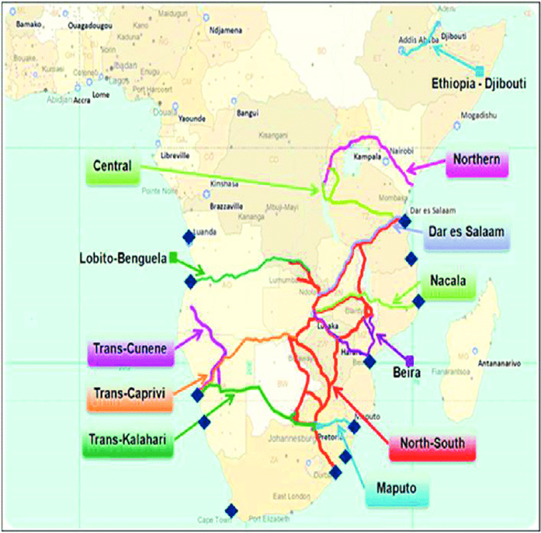
MALAWI SERVING REGIONAL CORRIDORS
Dar es Salaam Corridor – Links the port of Dar es Salaam in Tanzania to the DR Congo, Malawi, Zambia and southern part of Tanzania.
Nacala Development Corridor – stretches from Lusaka in Zambia, through Malawi to the port of Nacala in Mozambique.
Beira Development Corridor – Links the port of Beira in Mozambique to Malawi, Zambia, Zimbabwe and Mozambique.
Mtwara Corridor – Links the Tanzanian port of Mtwara to Malawi, providing an alternative route to the congested Dar es Salaam corridor
21

Slide 22
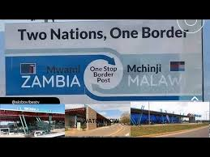
COLLABORATIVE FINANCING PROJECTS
Complementary Infrastructure Investments (Regional Corridor Approach): We have some World Bank and African Development Bank financed road projects that supports regional integration and trade (e.g. SATCP and the Multinational Nacala Corridor Development Project – Phase V)
Joint One Stop Boarder Posts Projects: Partnering with neighboring countries (Tanzania, Zambia and Mozambique) to co-finance five one-stop boarder posts
22

Slide 23
SETTING UP THE WAY FORWARD

Slide 24
SETTING UP THE WAY FORWARD
Innovative Financing Mechanisms
Road Funds should explore additional ways of raising resources to cover the gap created by the progressive reduction in fuel levies, including:
collecting from all current potential sources.
Expanding the tolling initiative programme.
Exploring PPPs in road infrastructure.
Issuing road infrastructure bonds leveraging on ringfenced revenues or annual budget allocations.
Strengthening Governance and Transparency
From the noted areas for improvement, the RFA has identified that further reforms are required for legislative revision, clarification and/or strengthening to:
Ensure full and timely remittance of fuel levies and other road user charges.
Improve project management and collaboration with implementing agencies.
To enforce quality and value for money in road infrastructure works.
24

Slide 25
SETTING UP THE WAY FORWARD
Climate Change Adaptation
Road Agencies need to manage the anticipated climate change effects through adaptation (as it is cheaper in the long-term) than annual reactive maintenance.
Road Agencies should incorporate climate data into road design/planning.
Effects of climate change emergencies are too huge to be managed by the Roads Fund resources alone. Significant Government and donor support is always needed (E.g., RCRP and RESTORE projects by the World Bank)
Collaborative corridor financing
SADC to develop integrated bilateral and regional transport policies that spells out clear strategies on road infrastructure development.
Bilateral and regional cooperation with respect to attracting strategic investments to undertake large scale infrastructure projects e.g., collaborative PPPs.
SADC countries should develop railway infrastructure and systems to complement road transport. There is a perceived overuse of roads in the region.
25

Slide 26
THANK YOU. MERCI. OBRIGADO.

