Slide 1
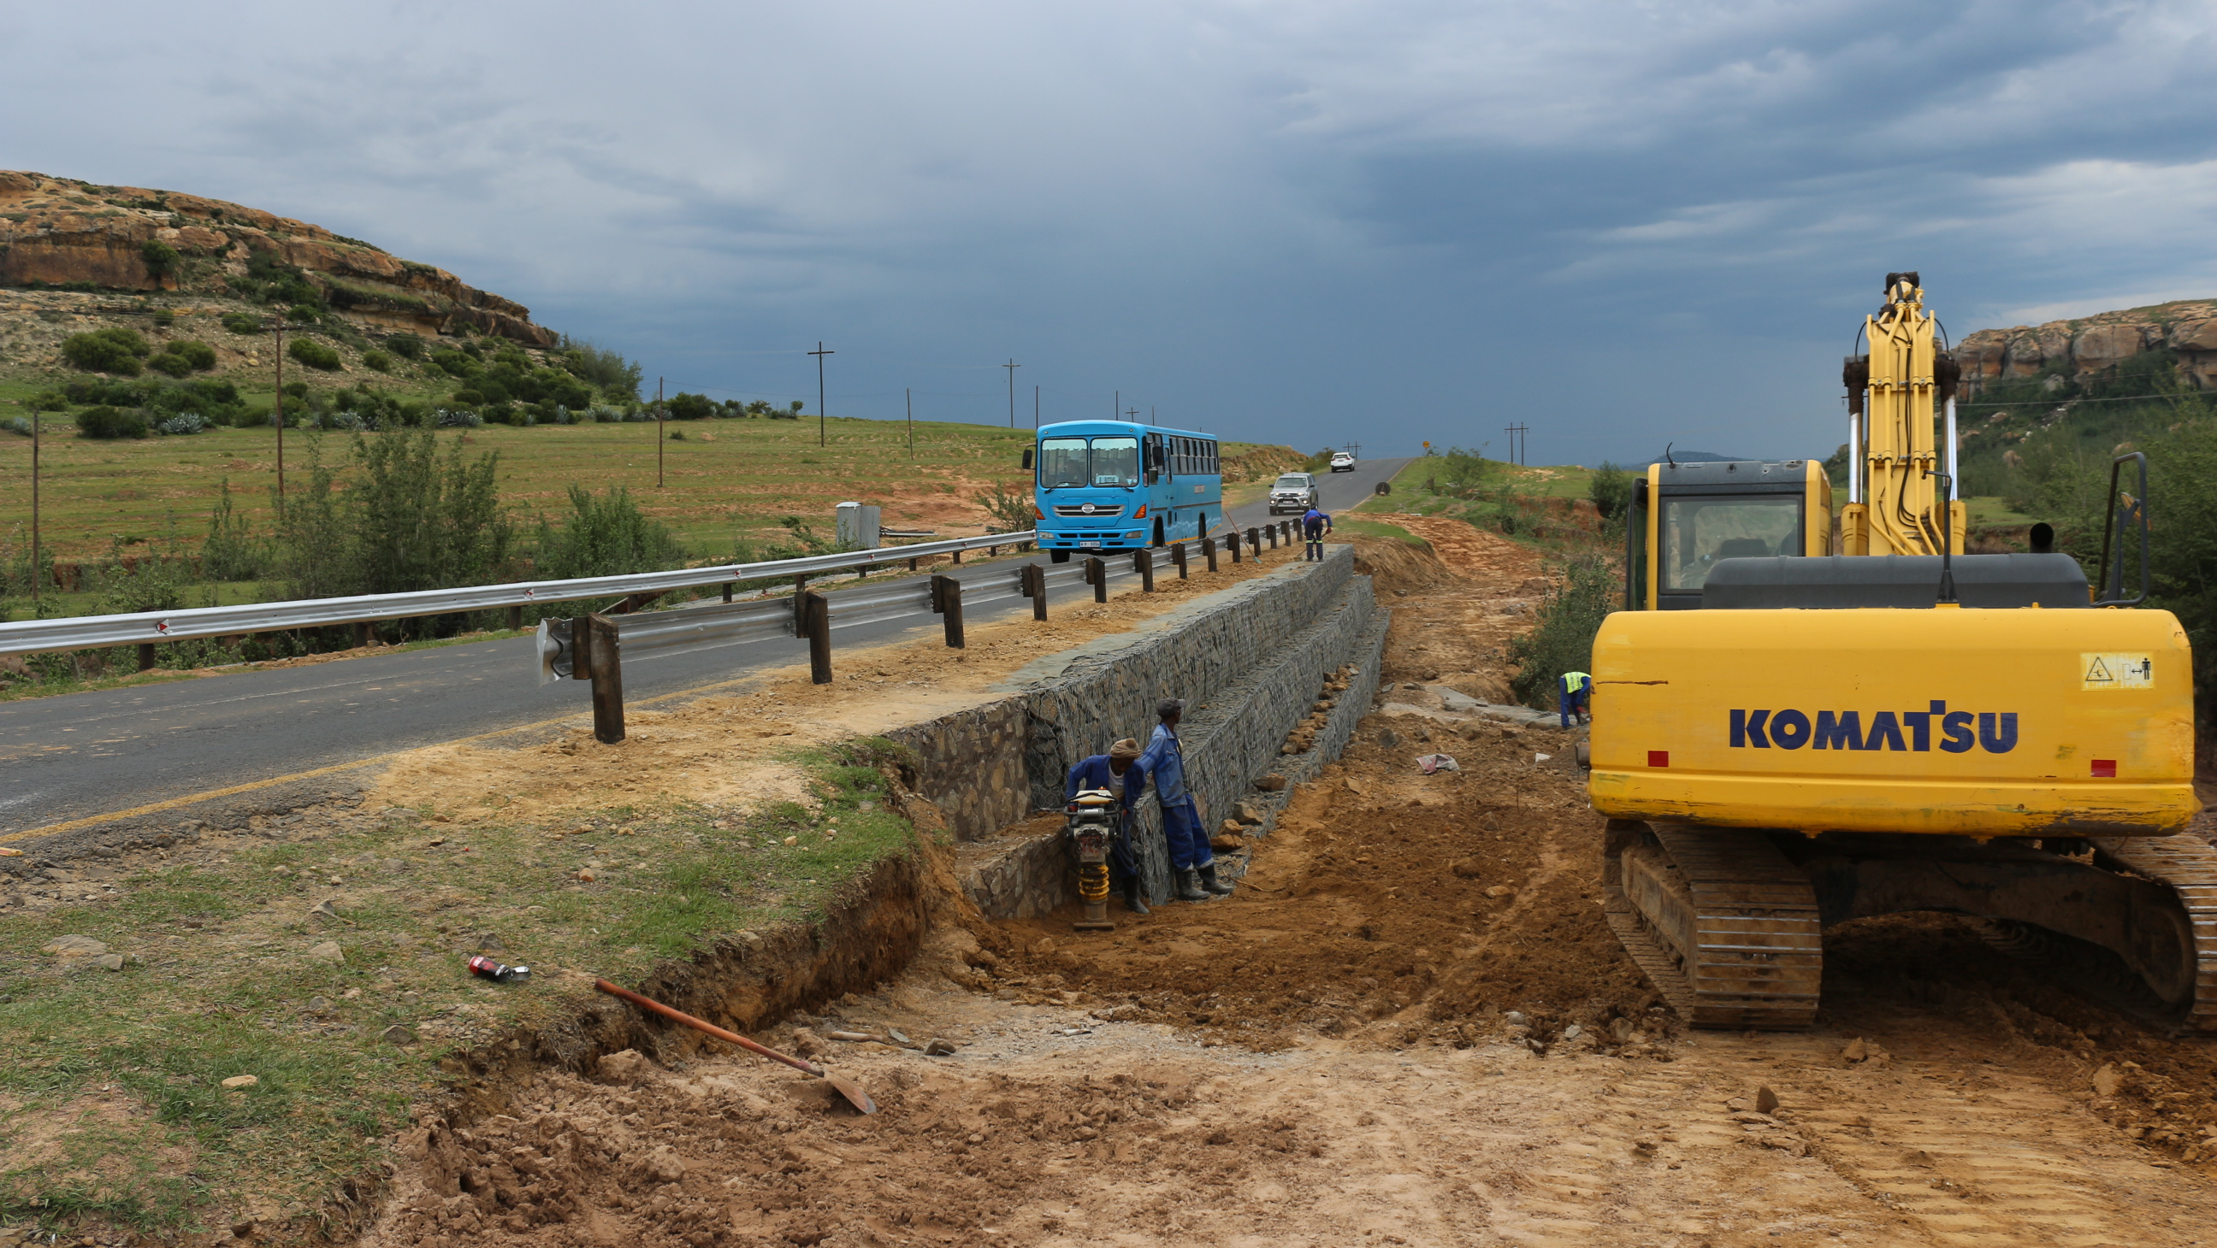


ASAFG
KINGDOM OF LESOTHO
Sustainable Financing Mechanisms for Road Infrastructure
APRIL 2026

Slide 2
Overview of Presentation
1. Current Road Financing Status Quo
2. Financing Challenges
3. Innovative Financing Mechanisms
4. Governance and Transparency
5. Climate Resilience
6. Regional Corridor Collaboration
7. Way Forward

Slide 3
Current Financing Framework
  Road Maintenance Levy (Petrol M0.84/L, Diesel M0.94/L)
  Toll Fees (currently situated at the Borders)
  Vehicle Registration and Licensing
  Special & Temporary Permits
  Overload Penalties
  Traffic Offence Fines
  Community Council Contributions
  Interest on Deposits
  Appropriations
  Donor Funding (currently not explored)
Notes:
This slide visualises how performance is monitored and reported across the accountability chain. The strategic flow begins with organisational Strategy, which informs the Annual Performance Plan (APP), tracked through the KPI Dashboard and reported quarterly. For 2023–24, performance achieved 92% collection, 87% disbursement, 98% compliance, and 80% stakeholder engagement. These metrics feed into the accountability chain — from the Board to the Ministry, Parliament, and finally the Public — promoting data-driven governance and transparency.

Slide 4
Traffic Demand & Tolling Strategy
    Current tolling limited to border toll gates.
    Traffic study underway exploring:
      Inland toll roads
      Strategic corridor tolling
      Electronic tolling systems
Goal: strengthen user-pay financing model

Slide 5
Innovative Financing Mechanisms
Indexation of existing road user charges
Transfer of all road user charges to the Fund
New permit systems (meter taxis, commercial operators)
Distance-based road user charges
Transit freight levy
PPPs on tolling
Explore grants
Road Fund Secreteriat Lesotho

Slide 6
Governance and Transparency
• Professional governing board
Minister responsible for finance to have power to review road user charges.
• Independent technical audits
• Transparent project allocation
• Performance monitoring of implementing agencies

Slide 7
LOGO
Climate Resilience
Climate risks affecting road networks:
• Flood damage
• Landslides
• Accelerated pavement deterioration
Mountain terrain increases vulnerability in Lesotho.

Slide 8
Climate Resilient Strategies
Improved drainage system
Slope stabilization
Climate-adapted pavement materials
Preventive maintenance programs
Road asset management systems
Supporting the Disaster Management Authority on road related disasters (Yet to solidify framework)

Slide 9
LOGO
Climate Financing Opportunities
• Green Climate Fund
• African Development Bank
• World Bank climate programs
Climate adaptation financing can support resilient road infrastructure.

Slide 10
LOGO
Way Forward
• Diversify revenue streams
• Introduce inland tolling where viable
• Mobilize grants and climate financing
• Strengthen governance and transparency
• Invest in climate-resilient infrastructure

Slide 11
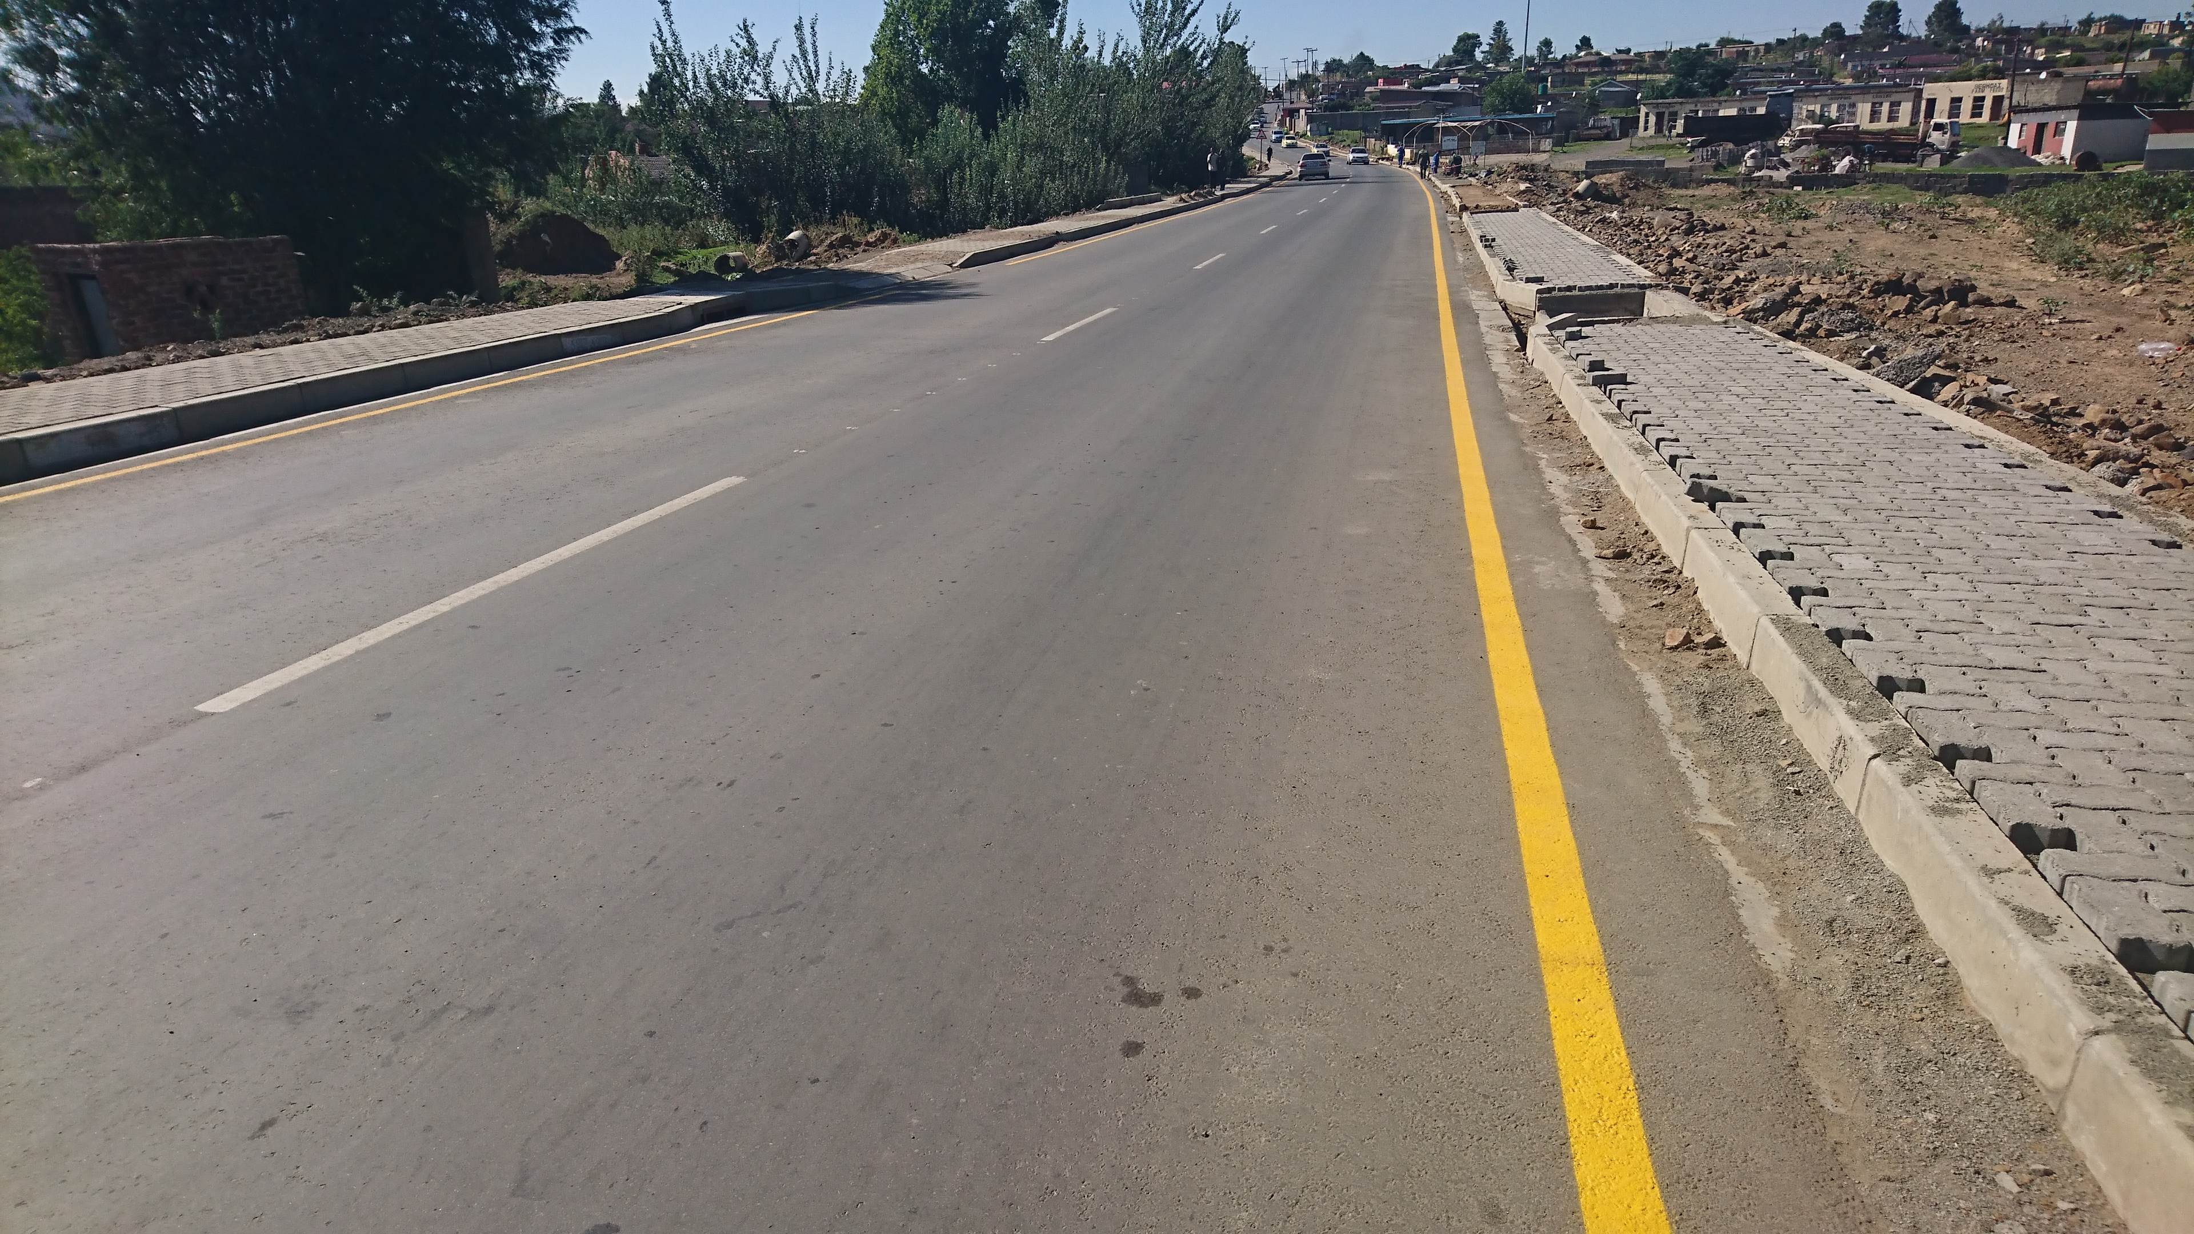
THANK YOU
KEÁ LEBOHA ☺
Ground Floor Former Dept.
of Rural Roads Building
Cnr Moshoeshoe & Senate Rds
Industrial Area, Lesotho
Tel: +266 22 216 000
Tel: +266 52 000 291
Email: info@roadfund.org.ls
Website: www.roadfund.org.ls
Maintaining a
smooth journey.

