Slide 1

Sustainable Financing Mechanisms for Road Infrastructures– Namibia Perspective
ASAFG-MOZAMBIQUE
APRIL 2026
Elton !Gaoseb
Executive: Programme Management Policy & Advice

Slide 2

PRESENTATION OUTLINE
2. Current Financial Model
3. Key Challenges
1. Context & Mandate
4. Innovation Solutions
5. Way Forward
6. Conclusions
Notes:
.

Slide 3
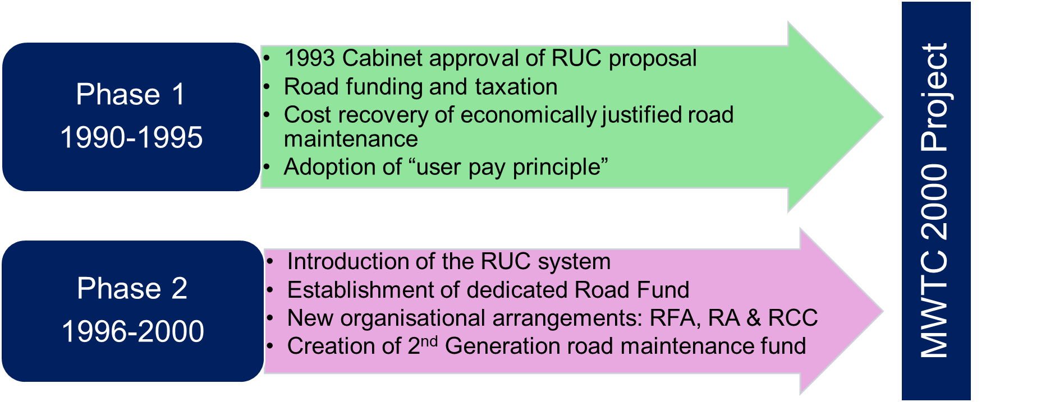

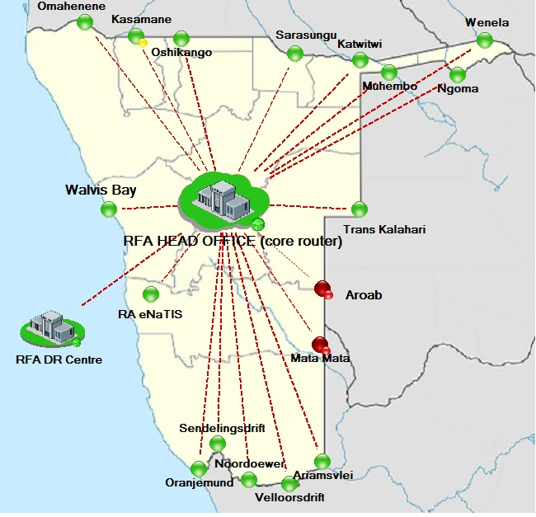
CONTEXT & MANDATE
HIGH-LEVEL GOVERNANCE STRUCTURE
MINISTRY OF FINANCE
ROADS AUTHORITY
ROADS CONTRACTOR COMPANY
MINSTRY OF WORKS AND TRANSPORT
ROAD FUND ADMINSTRATION
MINISTRY OF URBAN AND RURAL DEVELOPMENT
LOCAL AUTHORITIES
MUNICIPALITIES
TOWN COUNCILS
The reform agenda developed over 2 Phases
Create a cost-effective and competitive road sector
Revenue raised from road users instead from general taxpayer
Charging road users for the “consumption” of roads
Sector to maintain minimum maintenance service levels and standards
Increase accountability in the road management and funding arena
Provide for equal competition between road and rail transport
Reduce role of Govt in road sector & incentivise private sector participation
Align with regional and international best practice and standards
Objectives of the Namibian transformation programme
TOTAL (km) = 49,578
Bitumen surfaced 8,715 km
Gravel roads 39,713 km
Salt roads 326 km

Slide 4
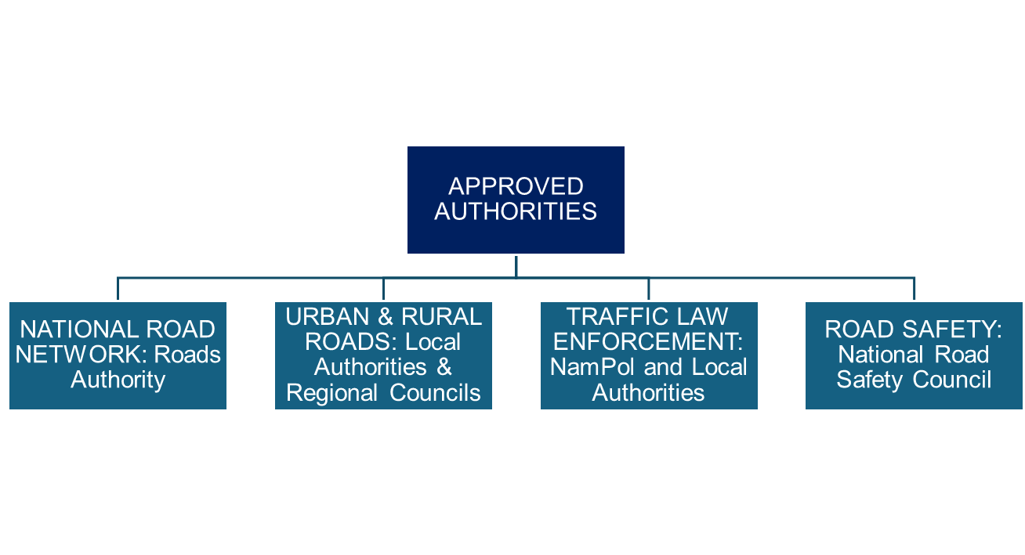
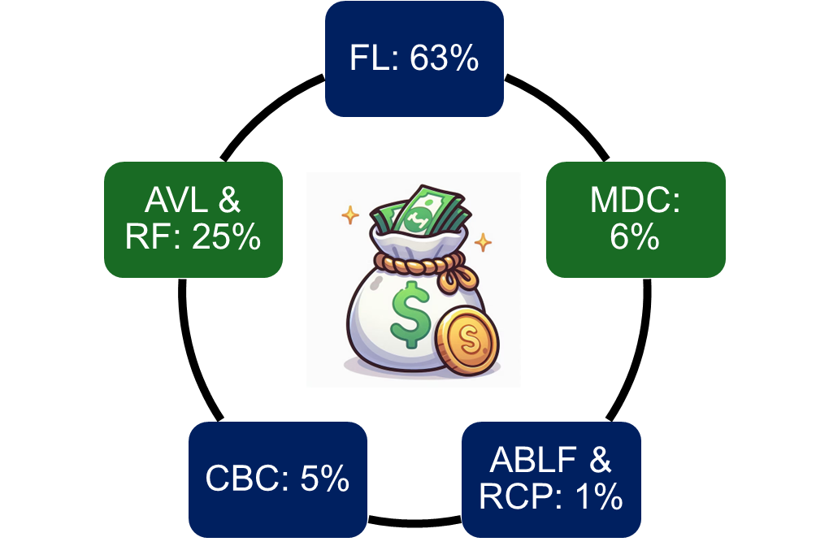
CURRENT FINANCIAL MODEL
Fuel Levies (FL)
Annual Motor Vehicles licence and Registration Fees (AVL & RF)
Cross Borders Charges (CBC)
Mass Distance Charges (MDC)
Abnormal Load Fees (ABLF)
Cross Border Carrier Permit (CBCP)
Domestic Road Carrier Permit (Taxi and local long-distance transport) (RCP)
Road funding is channeled through Recipients of the Fund as defined in the RFA Act
Prepared in terms of Section 21 of the RFA Act (Act 18 of 1999)
To be adopted by the RFA Board and approved by Minister of Finance
After consideration and input from key stakeholders
Presented as a Five-Year Business Plan for balancing cash revenue, expenditure, assets and liabilities (including loans)
86.3%
FUNDING DETERMINATION
(N$8.2bn)
The RFA’s sustainable road financing must ensure three things
(1) Adequacy of funding,
(2)Predictability of funding, and
(3)Credibility in how funds are collected and allocated.
In FY2025 N$4.06 billion was collected from the RUCS (funding gap remains N$5 billion)
BUDGET REQUEST
(N$8.4bn)
MANNER OF FUNDING
(N$3.7bn)

Slide 5
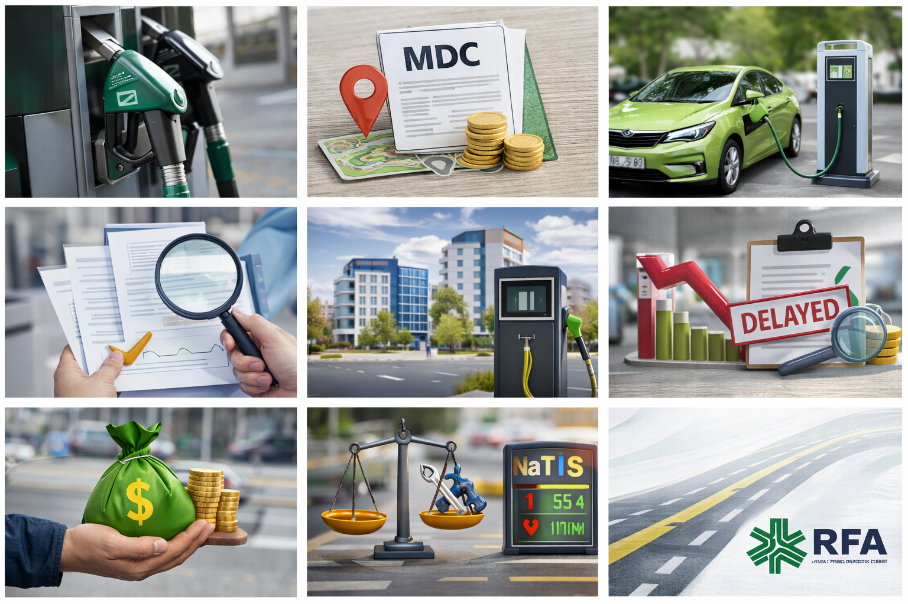
KEY CHALLENGES
Fuel Efficient vehicles-Fuel levies
Mass Distance Charges (MDC)-Manual System
Electric Vehicles
Procurement Delays – Affect overall budget
Monitoring and Evaluation –PSP’s
Funding Model - Roads Authority – Local and Regional Authorities
Reduction in fuel levy due to Global Factors
Improvement in existing systems required
Value for Money-Procedures Agreements
Balance- New Infrastructure vs Maintenance & Rehabilitation
Delays in implementation of Road Projects– Approved Authorities

Slide 6

INNOVATION SOLUTIONS
Modernization of existing road user charging instruments.
Automated Mass Distance Charging
Distance based charging system
Selective Tolling initiatives – political endorsement, stakeholder consultation and careful public acceptance management
Resilience-linked financing.
Urban road financing support through better information systems and possibly municipal-level complementary instruments
PPP’s

Slide 7
WAY FORWARD
Focus on strengthening the existing road fund system. This means improving revenue administration, accelerating MDC automation, stabilizing ERP and related business processes, improving auditability, and strengthening expenditure oversight.
RFA should continue refining allocation systems through URMS so that local authority funding becomes more evidence-based, transparent, and defensible.
In the short to medium term, Namibia should pursue selective revenue reform and supplementary financing measures. These include reviewing road user charges, advancing the policy process around tolling, and packaging the tolling case in a way that clearly links affordability, network benefits, and accountability.
In parallel, the RFA should institutionalize governance and transparency improvements. A quarterly road fund dashboard, stronger reconciliation controls, clearer reporting of allocations and outputs, and visible performance information would help strengthen legitimacy and willingness to support future financing reforms.
The climate-resilience agenda should also be embedded into this roadmap. This requires integrating risk into asset management, prioritizing drainage and vulnerability reduction, protecting planned maintenance budgets from repeated emergency diversion, and progressively establishing a resilience funding window.
At regional level, Namibia should continue advocating for corridor-based cooperation around maintenance standards, financing dialogue, freight charging principles, and cross-border enforcement coordination.

Slide 8
CONCLUSIONS
Namibian situation demonstrates that the issue is not whether a road fund exists, but whether it remains adequate, resilient, transparent, and reform-ready under growing pressure.
The RFA remains financially functional and strategically relevant, but the current road user charging system is not sufficient on its own to meet the full economically warranted road maintenance and rehabilitation requirement.
The country therefore needs a balanced approach: strengthen what already exists, modernize collection and governance, improve allocation credibility, integrate resilience, and progressively introduce complementary financing mechanisms such as tolling and corridor-focused approaches.
Sustainable road financing requires more than revenue mobilisation alone. It requires a financing system that is fair to users, strong in governance, credible in allocation, resilient to climate shocks, and capable of evolving with changing transport and fiscal realities.
Namibia’s ongoing work on MDC automation, URMS, tolling preparation, revenue reform, and stronger oversight provides a realistic and practical foundation for that transition.

Slide 9

www.rfanam.com.na

