Slide 1
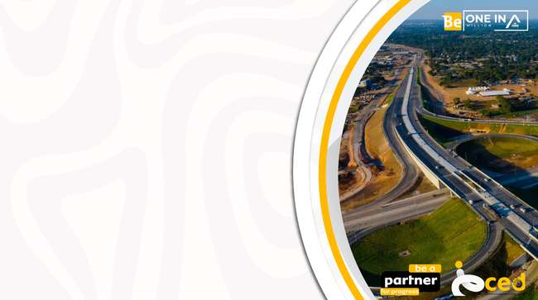
ARMFA SOUTHERN AFRICA FOCAL GROUP
MEETING
SÃO MARTINHO HOTEL, BILENE, MOZAMBIQUE
12 TO 17 APRIL 2026
Resuscitation of Road Maintenance Units
ARMFA SOUTHERN AFRICA FOCAL GROUP MEETING
Presented by : ZINARA, ZIMBABWE

Slide 2

Vision & Mission
Vision
Every centimeter of road has someone responsible.
Roads treated as living assets requiring continuous care.
Preventive maintenance as the foundation of sustainability.
Mission
Resuscitate and strengthen road maintenance units.
Combine human vigilance with modern equipment.
Ensure routine defects are addressed before they escalate.

Slide 3
Guiding Principles
Lengthy Man Approach – continuous inspection and accountability.
Human Resource Empowerment – revive retrenched units, train staff.
Equipment Investment – convert routine funds into durable machinery.
Decentralized Capacity – provincial → district → local authority units.
Sustainability & Accountability – ZINARA oversight and monitoring.

Slide 4
Objectives
Rebuild
Rebuild maintenance capacity.
Reduce
Reduce contractor dependence.
Improve
Improve responsiveness.
Enhance
Enhance rural access.
Create
Create sustainable maintenance model.

Slide 5
Background of Road Maintenance Units in Zimbabwe
Period | Key Events | Impact on Road Maintenance Units
1980s – Donor Support Era | International donors and IMF provided funding for road upkeep. | District road camps and Department of Roads (DoR) units functioned effectively, with adequate staff and equipment.
1991–1995 – ESAP Reforms | Economic Structural Adjustment Programme (ESAP) introduced austerity; donor and IMF support withdrawn. | Workers retrenched, funding reduced, maintenance units began to crumble.
2000s – Continued Decline | Persistent underfunding and lack of equipment. | Routine maintenance neglected, road conditions deteriorated further.

Slide 6
Background of Road Maintenance Units in Zimbabwe
Period | Key Events | Impact on Road Maintenance Units
2017 – Bond Financing & Contractors | Government adopted bond financing; private contractors hired for routine maintenance. | Unsustainable model: contractors fixed defects once but did not return when they reappeared, leaving recurring issues unresolved.
2020s – Recognition of Unsustainability | Bond financing proved inadequate for long-term upkeep. | Highlighted the need for permanent, responsive maintenance units.
Present – ZINARA Revival Strategy | ZINARA reviving in-house maintenance units under DoR, RIDA and local authorities. | Permanent staff can continuously address routine defects, building institutional capacity and reducing reliance on contractors.

Slide 7
Strategy for Resuscitation of Road Maintenance Units
Phase | Action | Focus | Expected Outcome
Phase 1 – Provincial Construction Units | Establish strong provincial-level construction units. | Target “emotional roads” (key trunk and strategic routes that carry heavy traffic and national sentiment). | Immediate rehabilitation of critical roads, restoring public confidence.
Phase 2 – Routine Funds Conversion | Convert routine maintenance funds into equipment acquisition. | Equip provincial units with graders, compactors, resurfacing machinery. | Enables units to carry out major rehabilitation works instead of relying on contractors.
Phase 3 – District-Level Expansion | Cascade provincial units into district sets. | Districts handle feeder and tertiary roads. | Builds localized capacity for continuous upkeep, reducing delays.

Slide 8
Strategy for Resuscitation of Road Maintenance Units
Phase | Action | Focus | Expected Outcome
Phase 4 – Road Authority Integration | Each road authority (DoR, RDCs, urban councils) to establish its own construction unit. | Institutionalize maintenance capacity across all authorities. | Ensures accountability and decentralization of road upkeep.
Phase 5 – Long-Term Strategy | Guarantee a minimum of one regravelling unit per RDC and a surfacing unit per town, DoR, RiDA. | Rural District Councils (RDCs) → gravel roads; Towns → surfaced roads. | Sustainable, permanent system for routine and rehabilitation works.
Phase 6 – Coordination & Oversight | ZINARA provides funding, monitoring, and technical support. | Aligns provincial, district, and local authority units. | Ensures efficiency, transparency, and long-term sustainability.

Slide 9
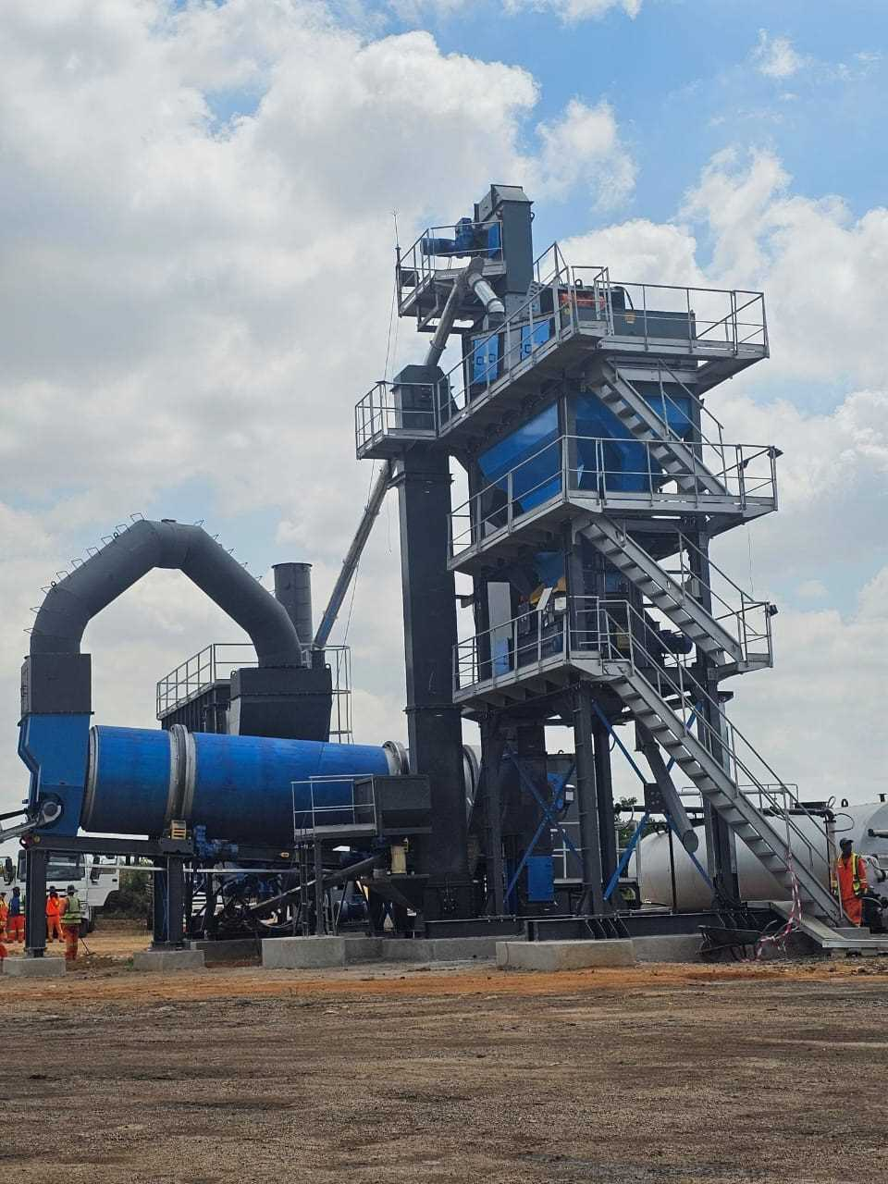
Equipment Procured
Asphalt plant for Department of roads under ministry of transport financed by ZINARA.

Slide 10
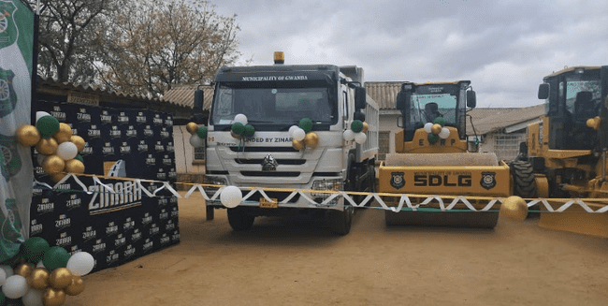
Equipment Procured
Road construction equipment procured for Gwanda Municipality using ZINARA funds

Slide 11
Equipment Procured
Routine Road Maintenance
Using Labour-Based Methods

Slide 12
How the Model Works
Road authority submit annual road maintenance program
Bills of quantities are produced for the planned works
Funds budgeted for machine hire to carry out works are used for purchase of equipment
A portion of annual allocation used to procure fuel, routine equipment maintenance and payment of casual labour wages

Slide 13
Cost Benefit analysis (5years)
Procuring Equipment vs. Financial Disbursement
Scenario Summary
10 Road Authorities (RAs)
Current model: Each RA hires graders, compactors, and tippers from private contractors
Proposed model: Road Fund procures equipment centrally and deploys to RAs

Slide 14
Option 1: Continuing with Financial Disbursements & Hiring Contractors
Annual Cost Per RA $256 000.00
Cost Component | Amount
Grader hire (1,000 hrs × $160/hr) | $160,000
Compactor hire (600 hrs × $80/hr) | $48,000
Tipper trucks (800 hrs × $60/hr) | $48,000
Total per RA per year | $256,000

Slide 15
Option 1: Continuing with Financial Disbursements & Hiring Contractors
Annual National Cost (10 RAs)
• $256,000 × 10 = $2,560,000 per year
5 Year Total Cost
• $2,560,000 × 5 = $12,800,000
Estimated Inefficiency / Leakage
Sector audits typically show 20–35% inflation, overbilling, idle time, and fuel manipulation.
Using 25% leakage:
• Leakage per year = $2,560,000 × 25% = $640,000
• Leakage over 5 years = $3,200,000
✅ 5 Year Cost of Option 1 = $12,800,000 + $3,200,000 = $16,000,000

Slide 16
Option 2: Centralized Procurement of Equipment

Slide 17
Five‑Year Financial Comparison
Category | Disbursement Model | Procurement Model
5‑Year Base Cost | $12,800,000 | $6,000,000
Leakage / Inefficiency | $3,200,000 | Negligible (machine hours tracked)
Total 5‑Year Cost | $16,000,000 | $6,000,000
Savings | — | $10,000,000 saved

Slide 18

The Future is AI in Road Maintenance
Road Condition Database in the Cloud
Centralized storage of inspection data, sensor readings, and traffic patterns.
Accessible to all road authorities for planning and monitoring.
AI-Powered Predictive Maintenance
Algorithms detect hairline cracks and forecast deterioration.
Prevents potholes and structural failures before they occur.
Digital Lengthman Concept
Replacing the physical inspector with AI-driven monitoring.
Drones, sensors, and machine vision continuously scan every centimeter of road.
Traffic Count & Analytics
AI tracks vehicle volumes to optimize toll collection.
Maximizes revenue streams and ensures fair allocation of funds.
Investor Confidence
Transparent, data-driven maintenance system attracts private investment.
Demonstrates sustainability and accountability in infrastructure management.

Slide 19
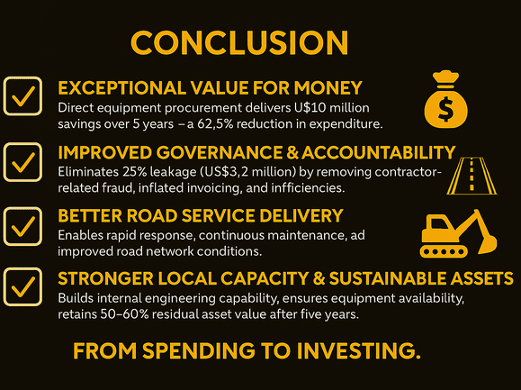

Slide 20
THANK YOU

